Slide 1
CS50 Lab 9 Andrew Holmes

Slide 2
Today’s Logistics
Brief Flask overview
Lab: Birthdays!
Finance guide & start!

Slide 3
Jinja!
{{ insert_useful_info_here }}

Slide 4
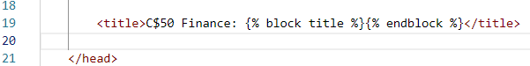
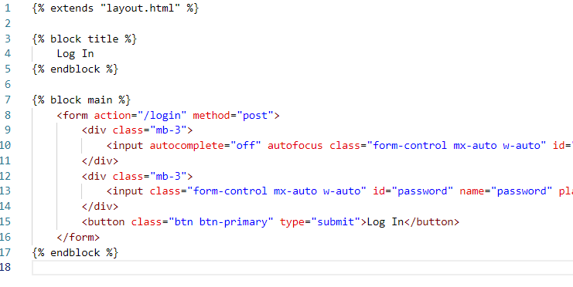
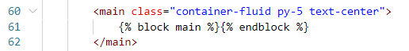
login.html code:
layout.html code

Slide 5
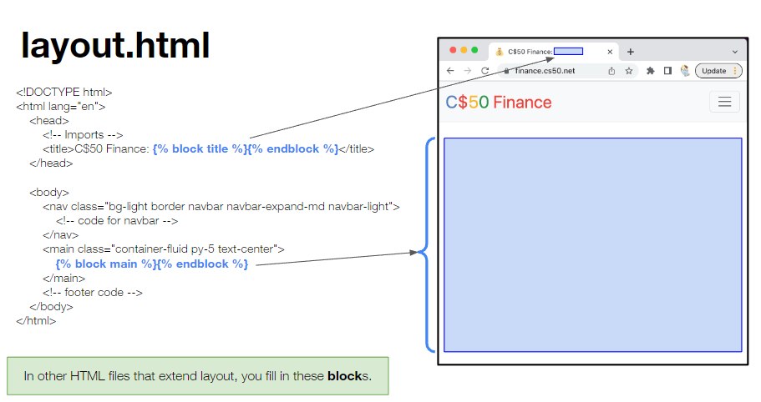

Slide 6
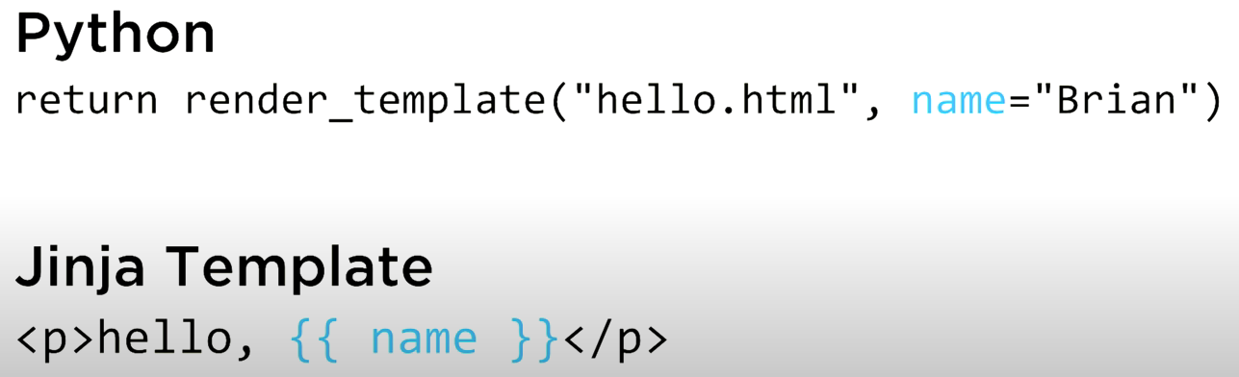

Slide 7
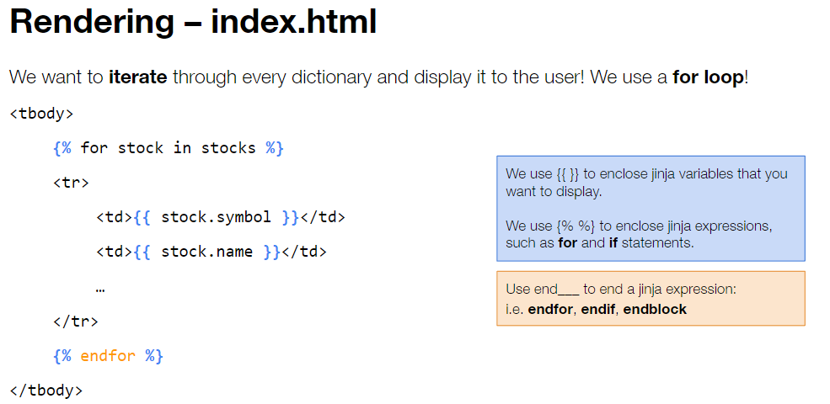

Slide 8


Lab problem:
https://cs50.harvard.edu/college/2022/fall/labs/9/

Slide 9
Finance 1: Setup
Create an IEX account here: iexcloud.io/cloud-login#/register/
Use a spam email, else you will get emails for the rest of time :P
Get an API token here: https://iexcloud.io/console/tokens
SAVE THIS IN A FILE SOMEWHERE
In your terminal, run export API_KEY=value

Slide 10
Finance 2: Understanding
There are three areas of code you need to edit:
App.py (all of the logic)
Templates (all of the page templates)
Finance.db (for later steps, particularly history, you need to add/change tables)

Slide 11
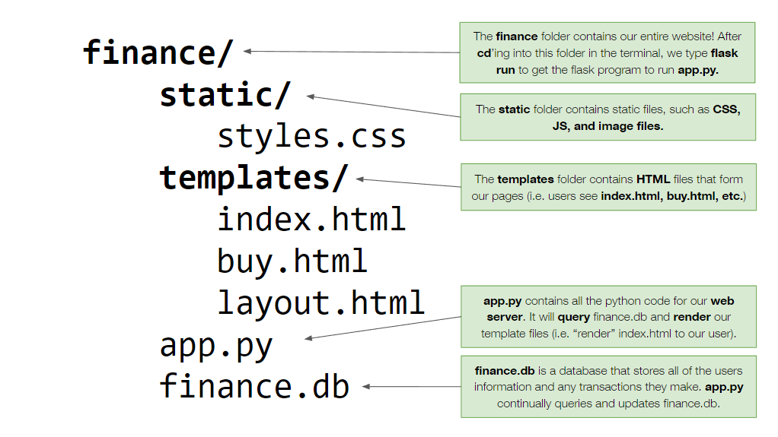

Slide 12
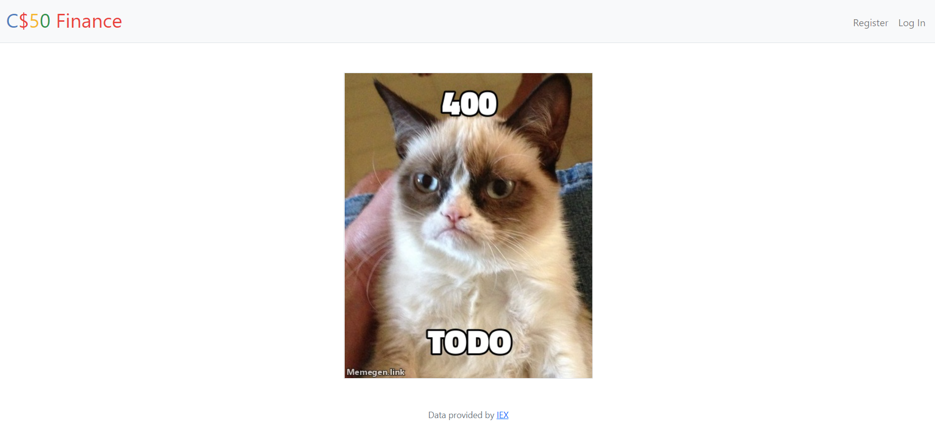
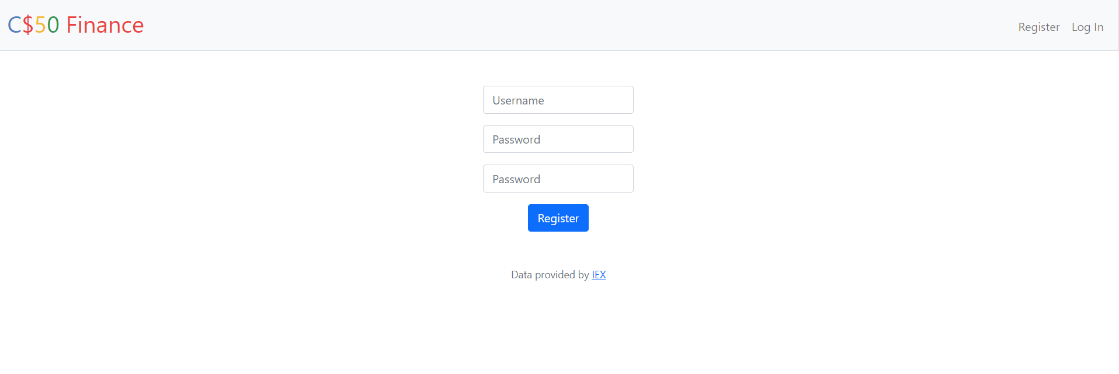
PHASE 1: Register
We need to allow users to register!
TODOs:
Create a register page with the appropriate form! (use login.html as template)
What to do on GET?
On POST, need to create new user:
Check all fields provided using request.form.get(“password”) etc
Hash password
Try to insert user, get id out if worked
Set session id and redirect(“/”)

Slide 13
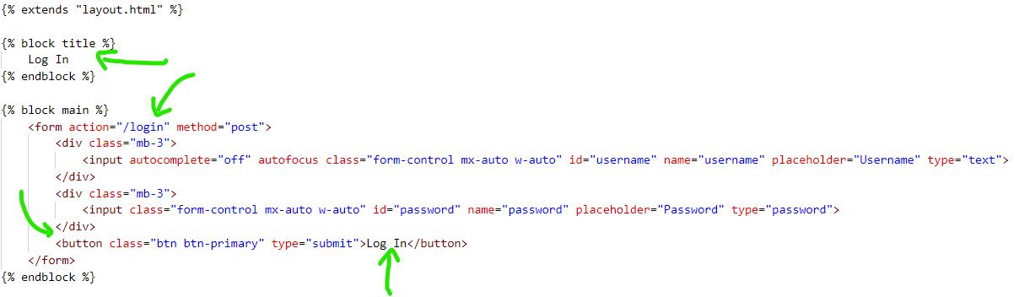
Register.html
Use login.html, make changes!

Slide 14
Register app.py tips
Check request.method!
Function given to you: generate_password_hash
Setting session id: session[“user_id”] = id
return redirect(“/”) or
return apology(“username taken”)

Slide 15
Redirect vs render_template
Render_template doesn’t do any logic, it just renders a page. This is risky if you are sending users to other routes – you could render the buy page anywhere using render_template(“buy.html”), even if they aren’t logged in!
Use render_template to render pages within the current route, i.e. if working on register, should only ever run render_template(“register.html”), if working on quote, only ever render_template(“quote.html or quoted.html”)
Otherwise redirect(<route>), e.g. return redirect(“/”)

Slide 16
Functions given (so far)
apology(message) -> renders the apology template with the appropriate error message for you. Use this, never render_template(“apology.html”)!
generate_password_hash(password) -> hashes password for you
render_template(template) -> renders page template
redirect(route)-> redirects user to another route
lookup(symbol) -> looks up stock data from IEX
db.execute(SQL string) -> runs the SQL query

Slide 17
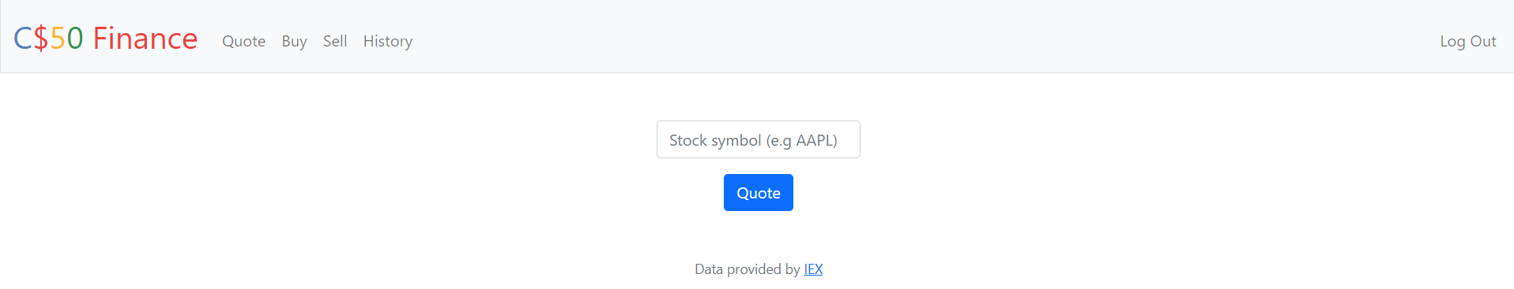
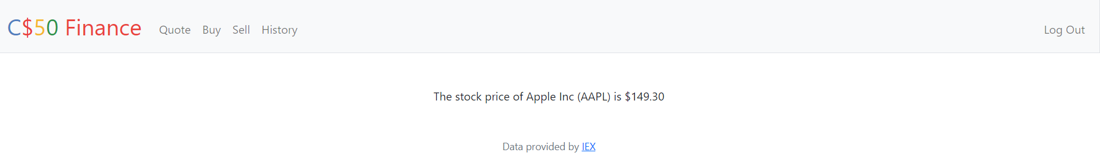
PHASE 2: Quote!
‘Quote’ page
‘Quoted’ page

Slide 18
PHASE 2: Quote!
Two pages:
Quote.html -> Form that takes a symbol and attempts to find a quote (Use previous work!)
Quoted.html -> Page that displays valid quote

Slide 19
PHASE 2: Quote!
If a symbol is not valid, lookup(symbol) will return an empty dictionary (easy to check this and return appropriate apology if so!)
To see what a lookup returns, how about rendering in page with just {{quote}} -> see the whole dictionary returned
{{quote.price | usd}} -> format as USD!

Slide 20
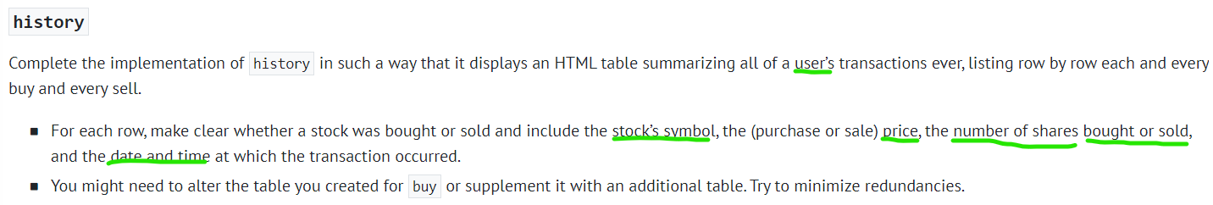
PHASE 3 & onwards
Transactions table advice:
You need a new table for buy. The guidance makes you change it for history. I think it’s easier to look ahead and only make this table once. What does it need?
Each transaction should have its own ID, as well as being associated with a user ID!
Use SQL’s powers to your advantage! Don’t need to use datetime from python, CURRENT_TIMESTAMP to the rescue :)

Slide 21
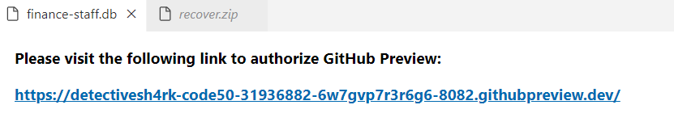
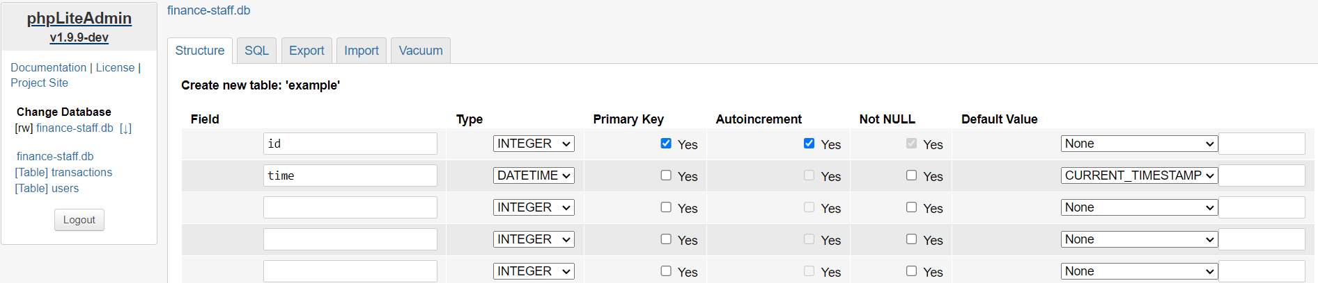
phpLiteAdmin
Create new table more easily than running the SQL commands yourself! An example of me creating a new example table on the staff solution database, with two fields done for you that might be useful!

Slide 22
Final Test advice:
Start early!!
Can be useful to use a different coding environment (e.g. VSCode) that will show errors.
COMPILE/RUN ANY CODE QUESTIONS
Use the fact that it is open book
Do some practice questions if you have time

Slide 23
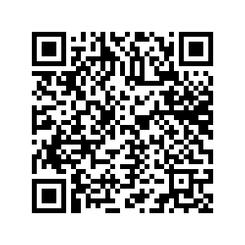
Final project ideas
Team up! More fun/ less frustration hopefully as a team. Support your partner – we will find out if you have not carried your weight
I can help! Tutorials still run, this is also when Ed, email and Slack channel will be most useful ☺
Pulled together a rough doc with some ideas/resources that may be useful to you (QR code too):
https://docs.google.com/document/d/1r8avVYwazVMFYH_JKXvFoNlwgYaBOSC9aPdaGEgW0vg/edit?usp=sharing

Slide 24
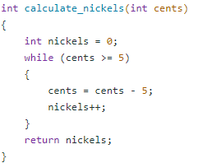
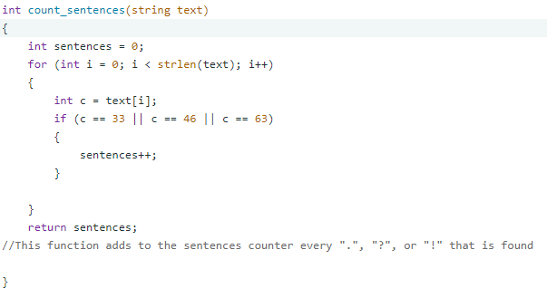
Closing thoughts
CS50 is hard – great job!
Loops! Variables!
ASCII! Arrays! Functions!
Week 1: Cash - Aurora
Week 2: Readability - John

Slide 25
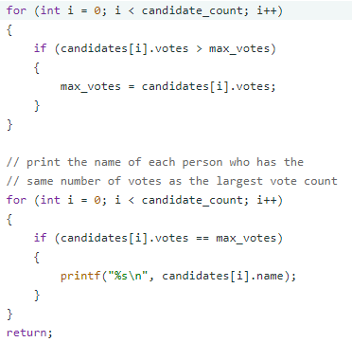
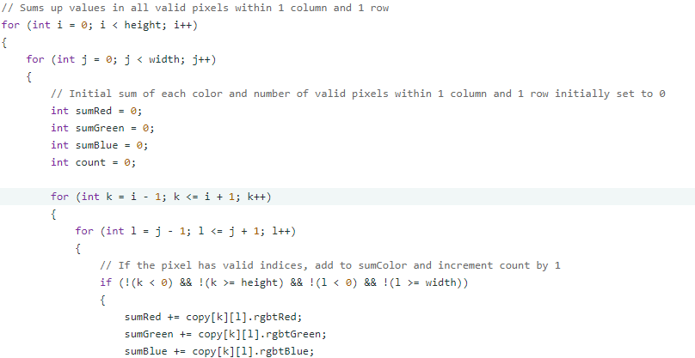
Files! Images! Memory management!!!!!
Week 4: Filter - Kevin
Structs! Sort algorithms!
Week 3: Plurality - Wissam

Slide 26
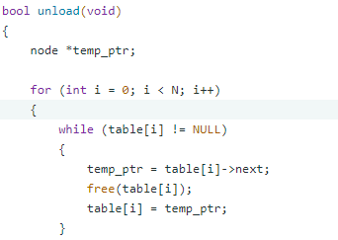
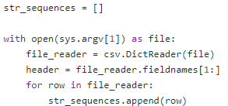
Linked lists & hash tables! POINTERS!
PYTHON! Dictionaries! Higher order functions!
Week 6: DNA - Meghan
Week 5: speller -Cristopher

Slide 27
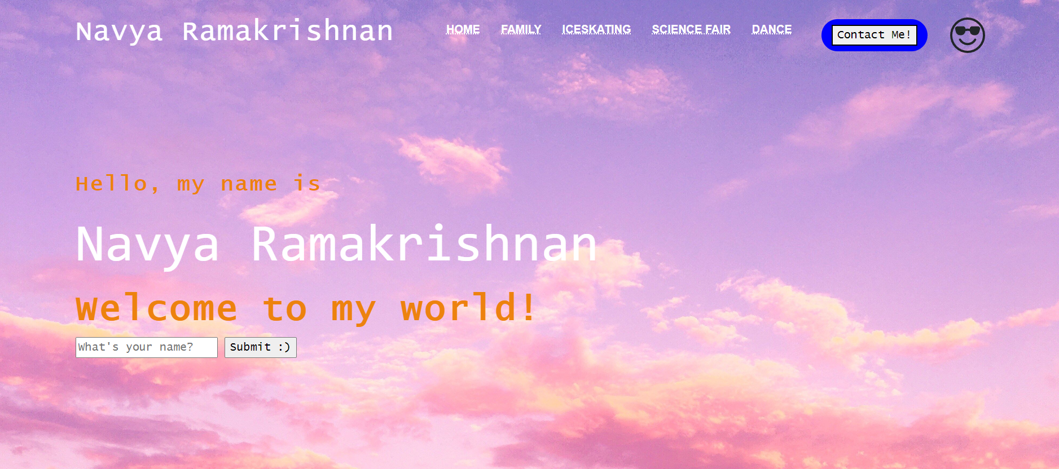
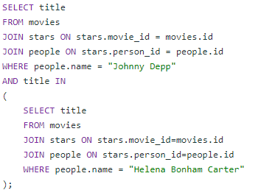
SQL! Databases!
Week 7: movies - Anthony
Week 8: homepage -Navya
HTML, CSS AND JAVASCRIPT!!!

Slide 28
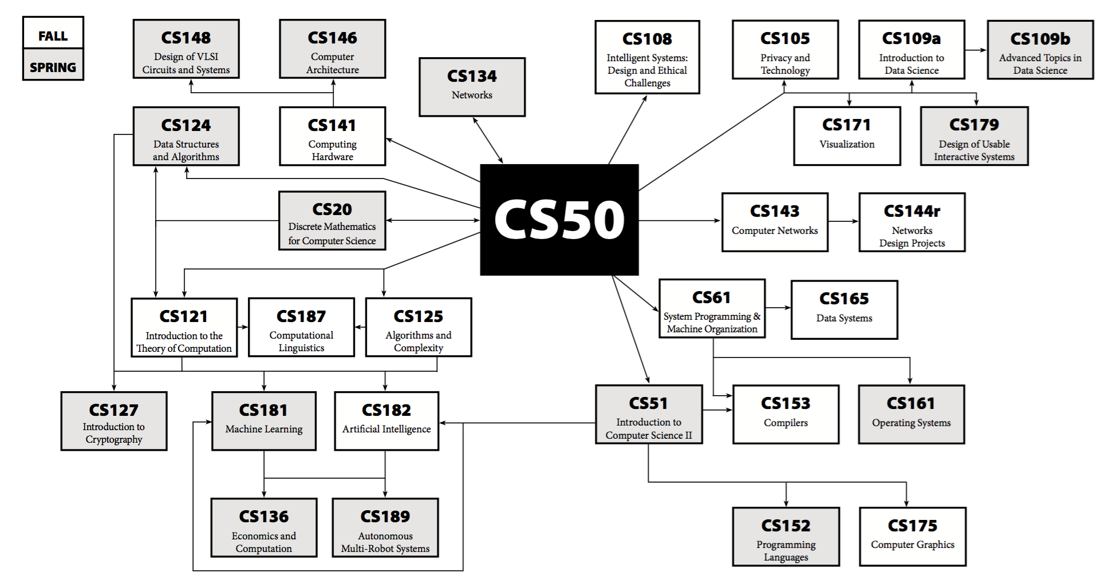

Slide 29

Q guide
Appreciate feedback!
Especially:
Honest
Positive
Constructive criticism

Slide 30

Thanks for coming <3
IG: andrewholmes12 Number: (857) 928-8419

Slide 31

Not quite goodbye!
Come to CS50 Fair, Hackathon (I wanna help on projects!)

